Slide 1
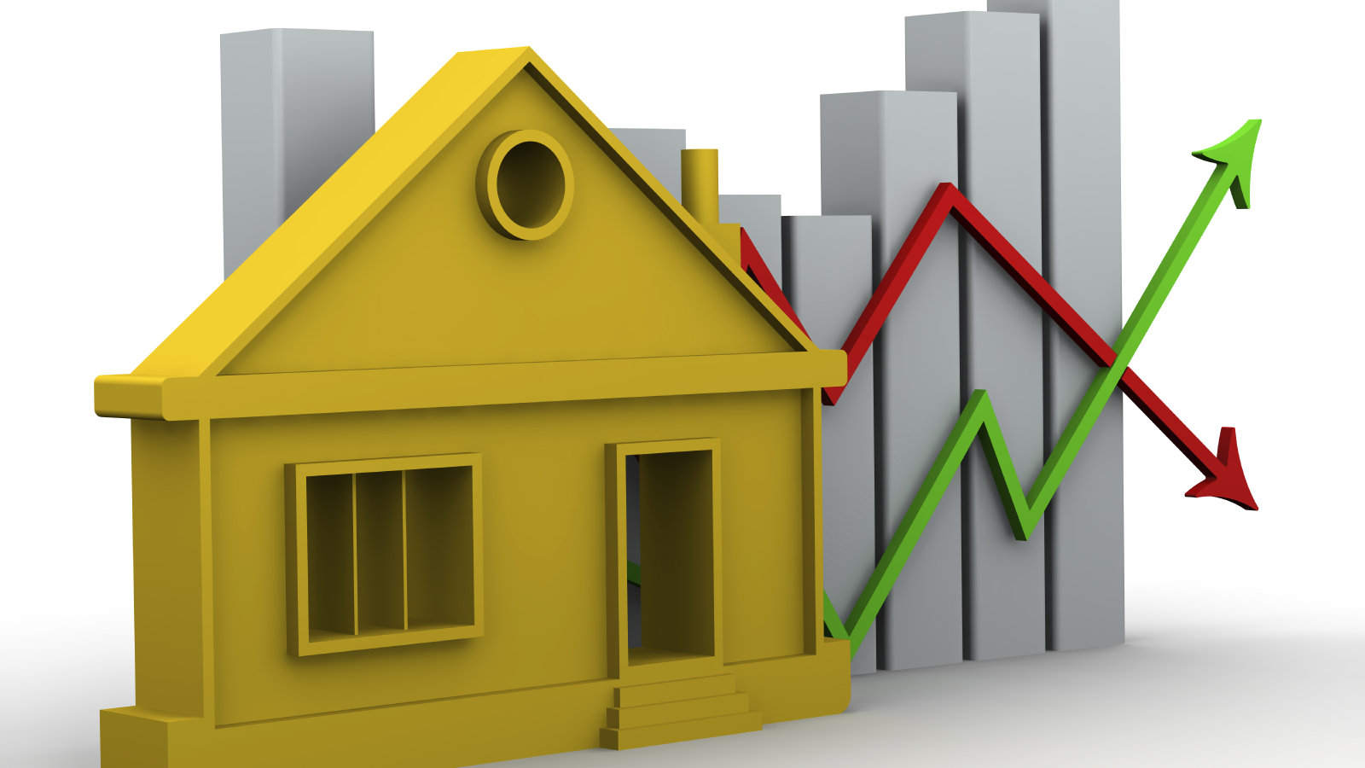
House price prediction
Presented by,
Lekshmi ChandraN Sheela
Patricia Adolph
Pooja selby

Slide 2
Contents
Introduction
Exploratory Analysis
Model Building
Conclusion
References

Slide 3
Introduction
House prices increase every year, so there is a need for a system to predict house prices in the future. House price prediction can help the developer determine the selling price of a house and can help the customer to arrange the right time to purchase a house.
The dataset for predicting house prices have been downloaded from the Kaggle’s House Price competition, where the dataset has 81 features with 1460 observations.
‘Sales Price’ is the target variable.
81 attributes
44 Categorical
35 Numerical
Id
Sales Price

Slide 4
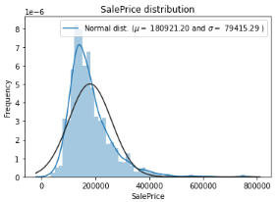
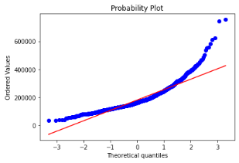
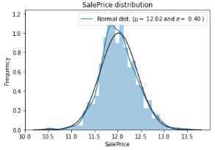
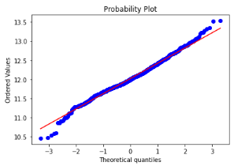
Target variable – sales price
The ‘SalesPrice’ is highly positively skewed
Log(SalesPrice) is behaving normally!!!

Slide 5
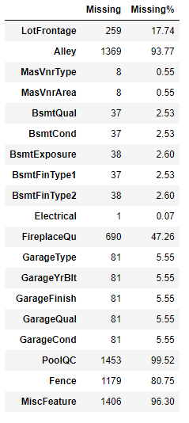
Handling missing values
Dataset contain null values due to many reasons such as data is not recorded during the data collection phase, data corruption, etc.
Out of 81 attributes, 19 attributes had missing values.
Missing value imputation is one of the common technique used to handle missing values.
Is the missing value imputation applicable in our scenario?

Slide 6
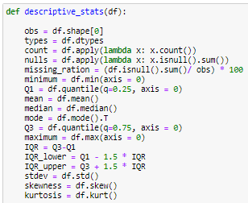
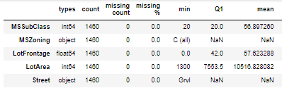
MEASURE OF Central tendency and Dispersion
Measure of Central Tendency: Mean, Median, and Mode.
Measure of Dispersion: Range, IQR, Standard Deviation, and Variance.
We have created a user-defined function called descriptive_stats() that calculates: types, count, nulls, missing_ration, minimum, Q1, mean, median, mode, Q3, maximum, IQR, IQR_lower, IQR_upper, stdev, skewness, and kurtosis

Slide 7
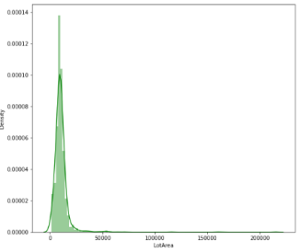
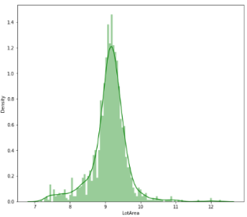



Variable transformations
We have conducted variable transformations for numerical variables and categorical variables separately.
Numerical Variables – Transformed positively and negatively skewed numerical variables to normal distribution using ‘log’ and ‘exponential’ transformation.
Categorical Variables – Transformation using encoding, simplification, and combination.
Polynomials (square, cube, and square root) on the top 10 features of House Price data.
After variable transformations!!! 119 variables!
Combination of existing features
Most important Features

Slide 8
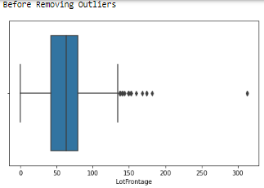
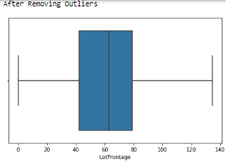
Outlier Detection and Handling
Outlier is handled based on IQR upper and IQR lower values
If (obs) >= IQR_upper then IQR_upper
Else if (outliers) <= IQR_lower then IQR_lower
Else obs
No outliers have been removed from the hp dataset to prevent the loss of data.

Slide 9
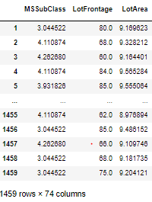
Identify potential variables for modelling
Correlation: There are 76 strongly correlated variables with ‘sales price’
Removed variables using VIF function. Build an initial model using variables VIF < 10.
74 variables are available for the modelling!!!

Slide 10
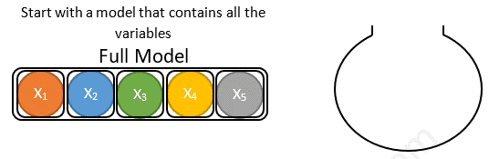
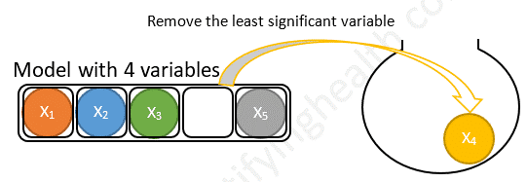
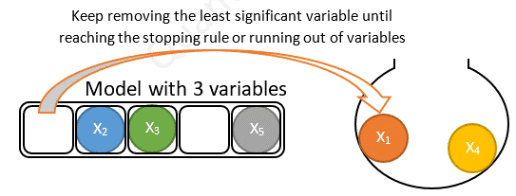
Multiple linear stepwise backward selection model
Backward stepwise selection is a variable selection method which:
Begins with a model that contains all variables under consideration.
Then starts removing the least significant variables one after the other.
Until a pre-specified stopping rule is reached or until no variable is left in the model.

Slide 11
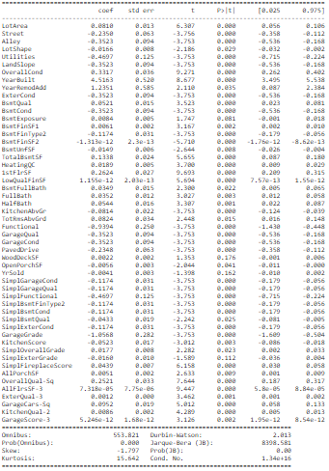

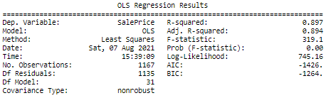
House price Prediction – Multiple linear stepwise backward selection model
(Train, Test) : (80, 20)
Why stepwise regression?
Identify initial model using Stepwise Backward Regression using Adjusted R squared value and p-value significance

Slide 12
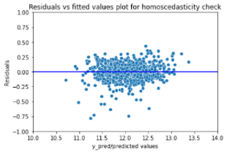
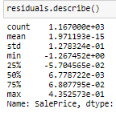
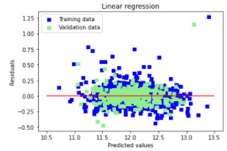
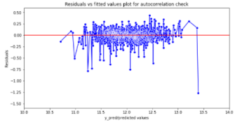
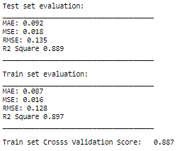
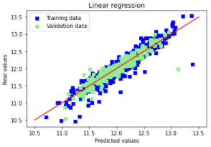
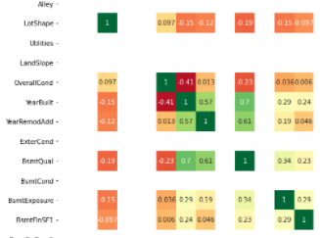
Validating assumptions of the fitted model
Mean of Residuals: 1.971192893764631e-15
Homoscedasticity: No pattern observed in the plot
Residuals are normally distributed
Autocorrelation of residuals: Durbin- Watson Test value is 2.01 and no pattern observed
Multicollinearity: Correlation detected from corrplot
Evaluation Metrices

Slide 13
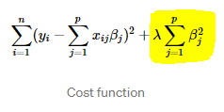
Ridge regression
Ridge regression is a method of estimating the coefficients of multiple-regression models in scenarios where independent variables are highly correlated.
Ridge regression adds “squared magnitude” of coefficient as penalty term to the loss function.
This technique works very well to avoid over-fitting issue.
Here the highlighted part represents L2 regularization element.
If lambda is zero then you can imagine we get back OLS. It’s important how lambda is chosen.

Slide 14
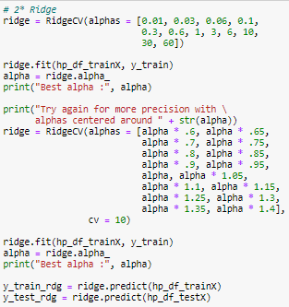
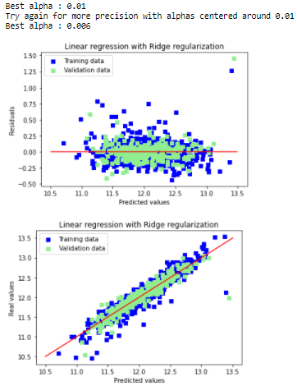
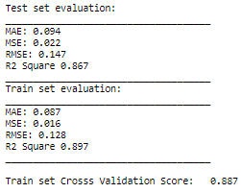
Ridge regression house price model evaluation
Mean Absolute Error (MAE)
Mean Squared Error (MSE)
Root Mean Squared Error (RMSE)
R square

Slide 15
references
House Price Prediction | Kaggle https://www.kaggle.com/c/house-prices-advanced-regression-techniques/data?select=train.csv
Forecasting: Principles and Practice (2nd ed). 12.9 Dealing with missing values and outliers. (n.d.). https://otexts.com/fpp2/missing-outliers.html.
Measures of central tendency and variability. ABCTE Prepare to Teach Workshops. (n.d.). https://www.americanboard.org/ptk/measures-of-central-tendency-and-variability/.
Selection process for multiple regression. Complete Dissertation by statistics solutions. (n.d.). https://www.statisticssolutions.com/free-resources/directory-of-statistical-analyses/selection-process-for-multiple-regression/?__cf_chl_jschl_tk__=pmd_74389c44f71e14addbe64fdabc32043ac6a94f12-1628193864-0-gqNtZGzNAk2jcnBszQm6
DEI, M. (2019, December 28). Catalog of Variable Transformations To Make Your Model Work Better. BOOK “DATA ANALYSIS TECHNIQUES TO WIN KAGGLE.” https://towardsdatascience.com/catalog-of-variable-transformations-to-make-your-model-works-better-7b506bf80b97.
Ashok, P. (2020, October 15). What is Ridge Regression? Great Learning. https://www.mygreatlearning.com/blog/what-is-ridge-regression/.

Slide 16

Thank you!

